Slide 1

Sprint 4
SLW Home Improvements
Members
Carson Hatem – Systems Analyst
Austin Bing-Zaremba – Business Analyst
Christian Lancaster – Co-Product Owner
Jackson Ingalls – Database/Programming Coordinator

Slide 2
Training Introduction
In this training we will be giving a basic overview of our system
We will also go through the Key Tasks for a manager of SLW Home Improvements
This system will help the company work more efficiently, improve customer experience, and streamline operations.

Slide 3
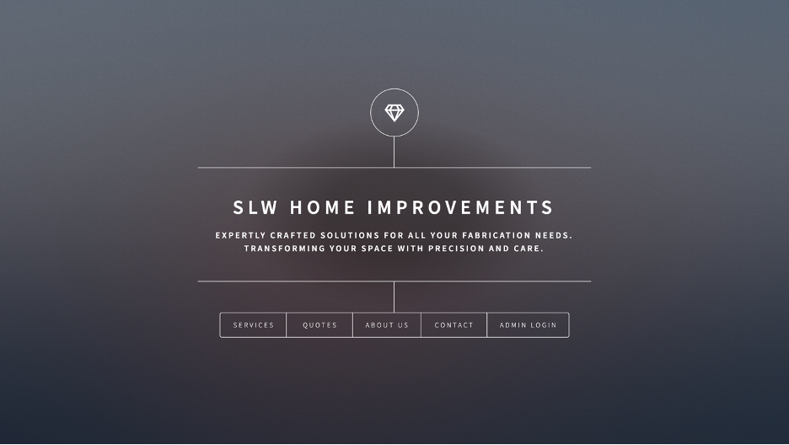
System Overview – Home Page

Slide 4
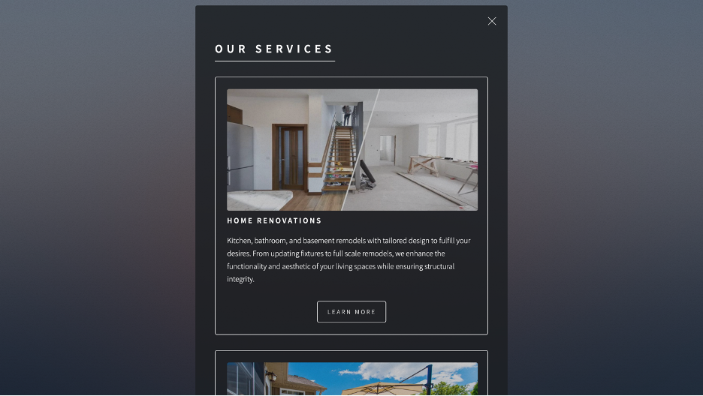
System Overview – Services Page

Slide 5
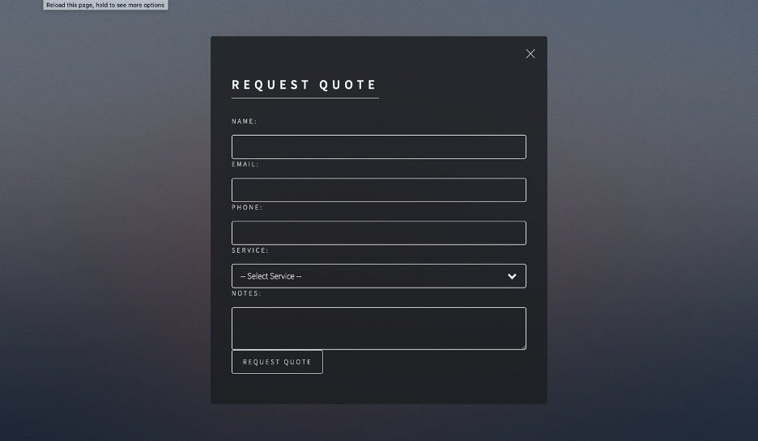
System Overview – Quotes Page

Slide 6

System Overview – About Us Page

Slide 7
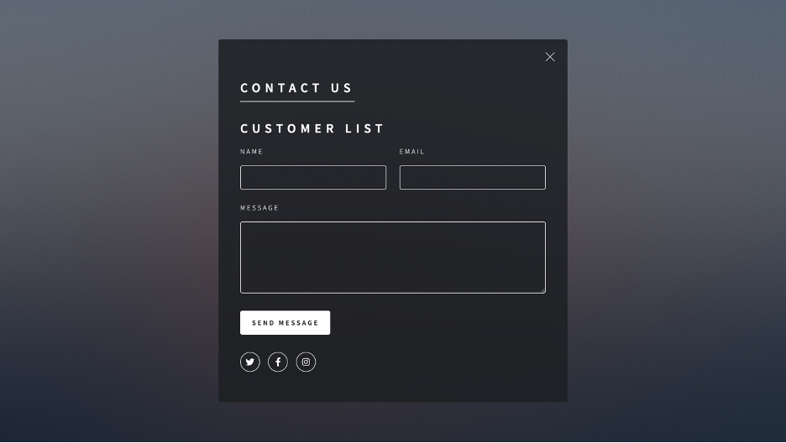
System Overview – Contact Us Page

Slide 8
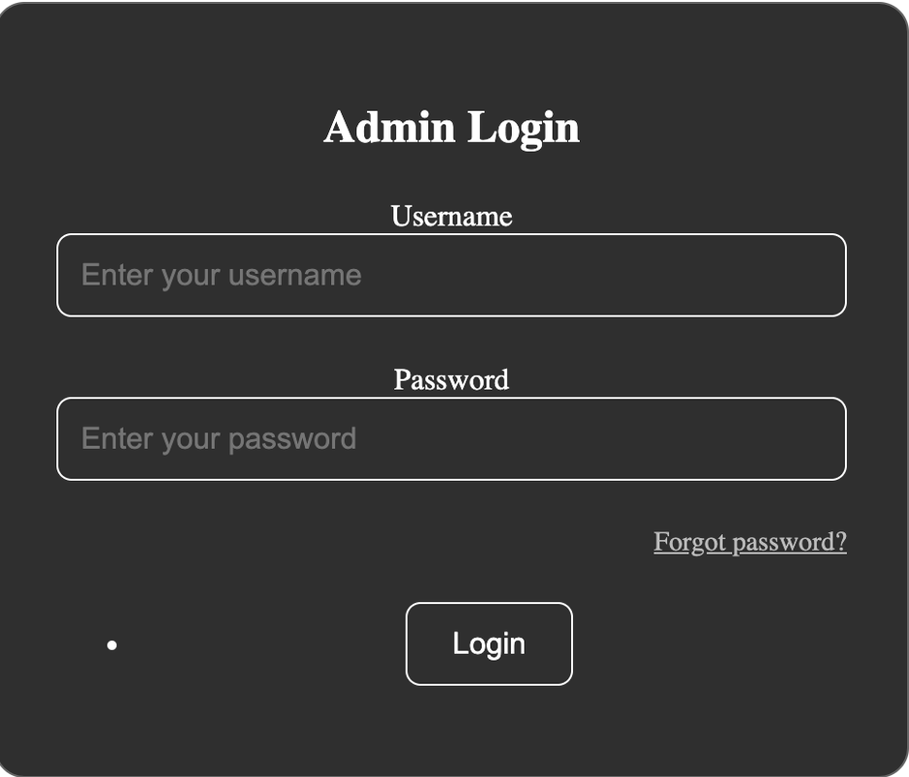
Key Task 1 – Logging In

Slide 9
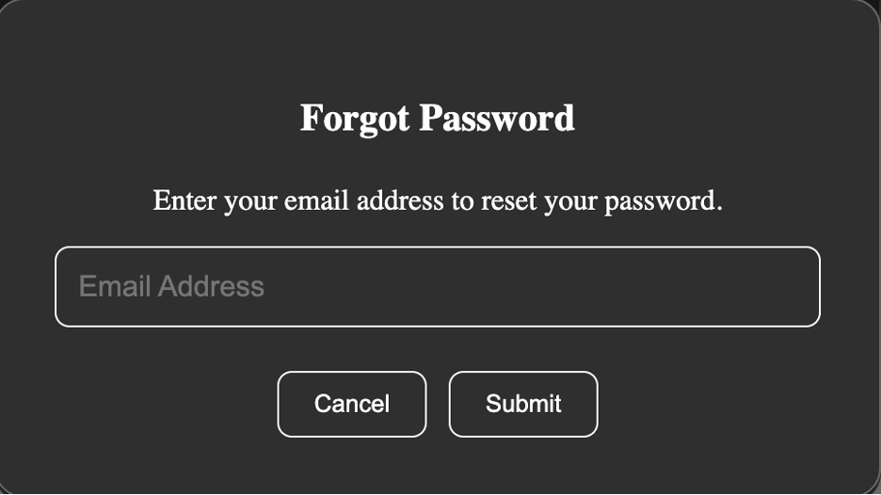
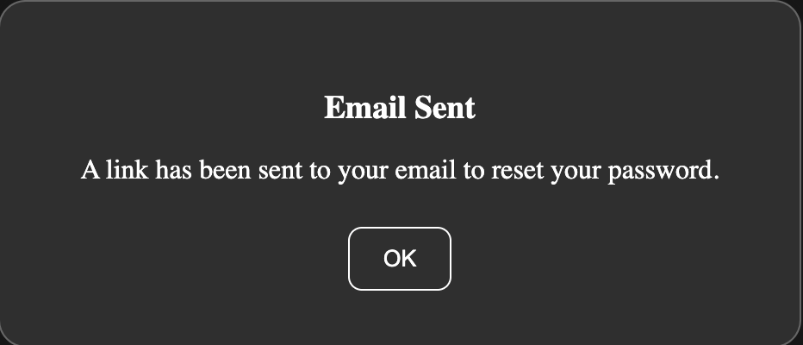
Key Task 1 – Forgotten Password

Slide 10
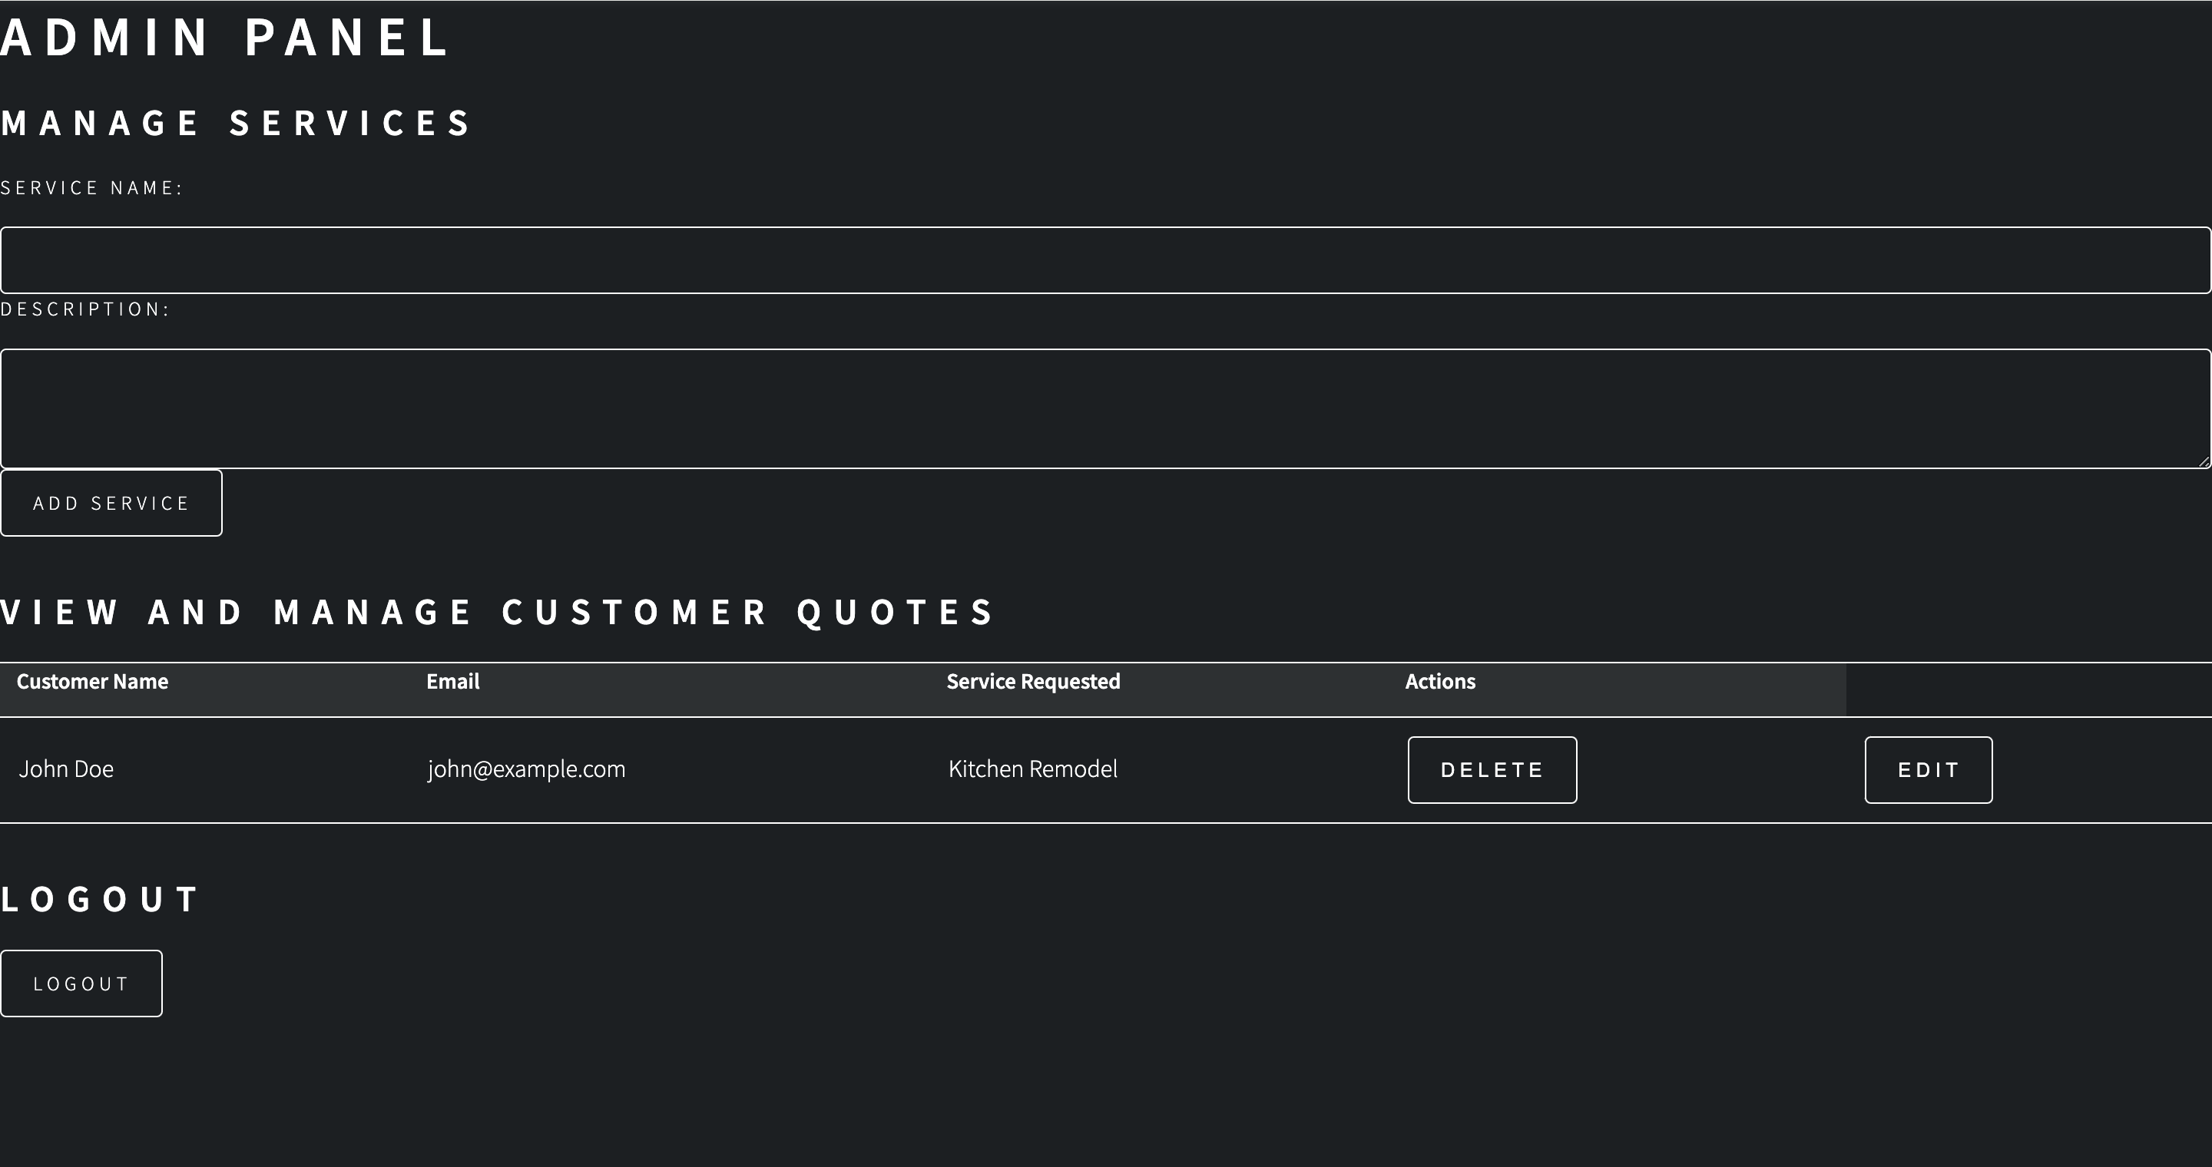
Key Task 1 – Logged in View

Slide 11
Key Task 2 – Managing Services

Slide 12
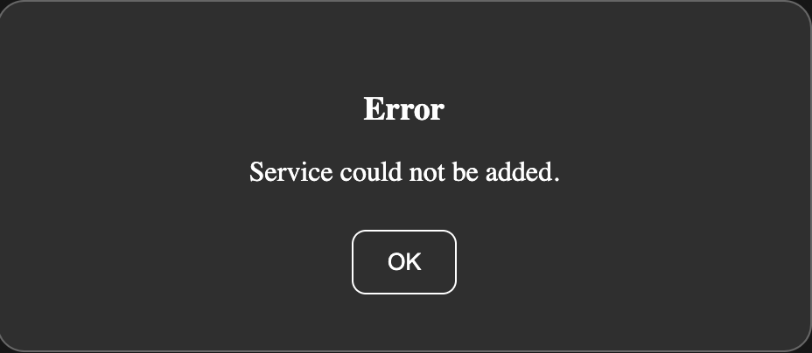
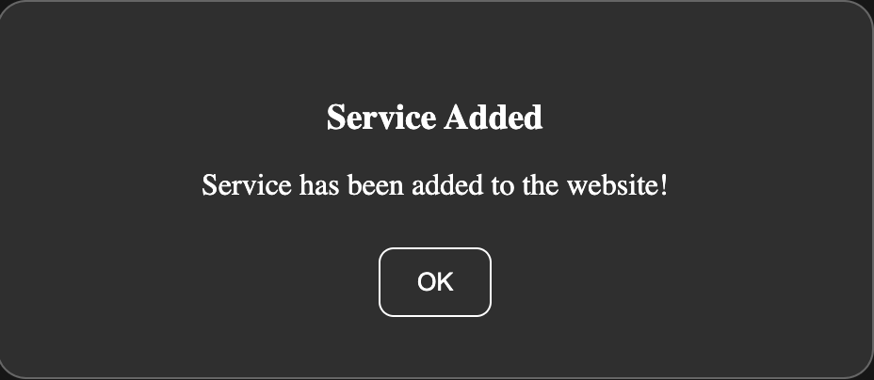
Key Task 2 – Managing Services Pop Ups
Failed
Successful

Slide 13
Key Task 3 – Customer Quote View

Slide 14
Key Task 4 – Customer Quote Management

Slide 15
Key Task 4 – Delete Customer Quote

Slide 16
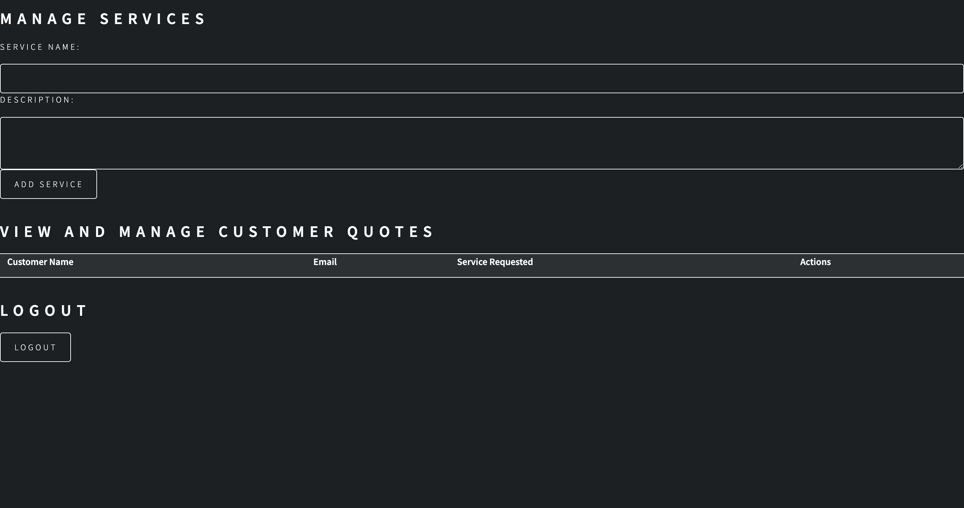
Key Task 4 – Customer Quote Deleted

Slide 17
Key Task 4 – Edit Customer Quote

Slide 18
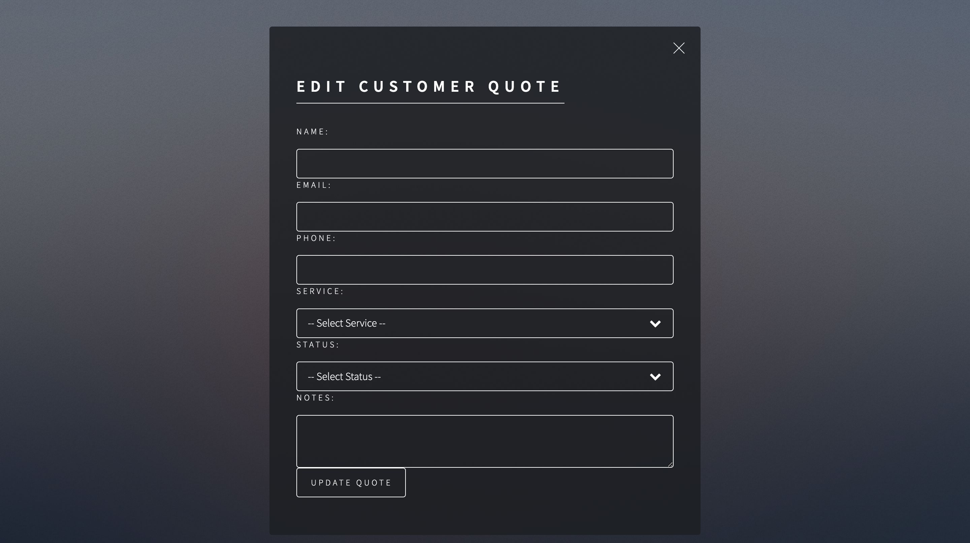
Key Task 4 – Edit Customer Quote Page

Slide 19
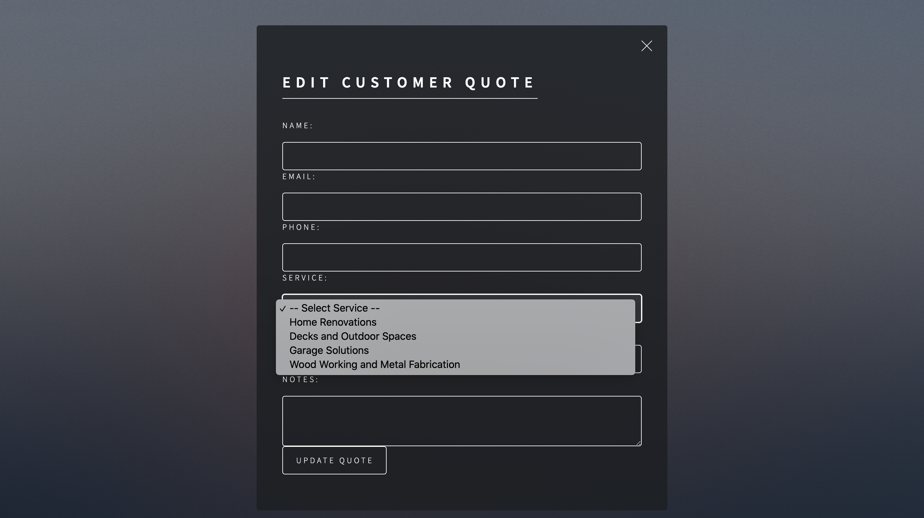
Key Task 4 – Edit Customer Quote Service

Slide 20
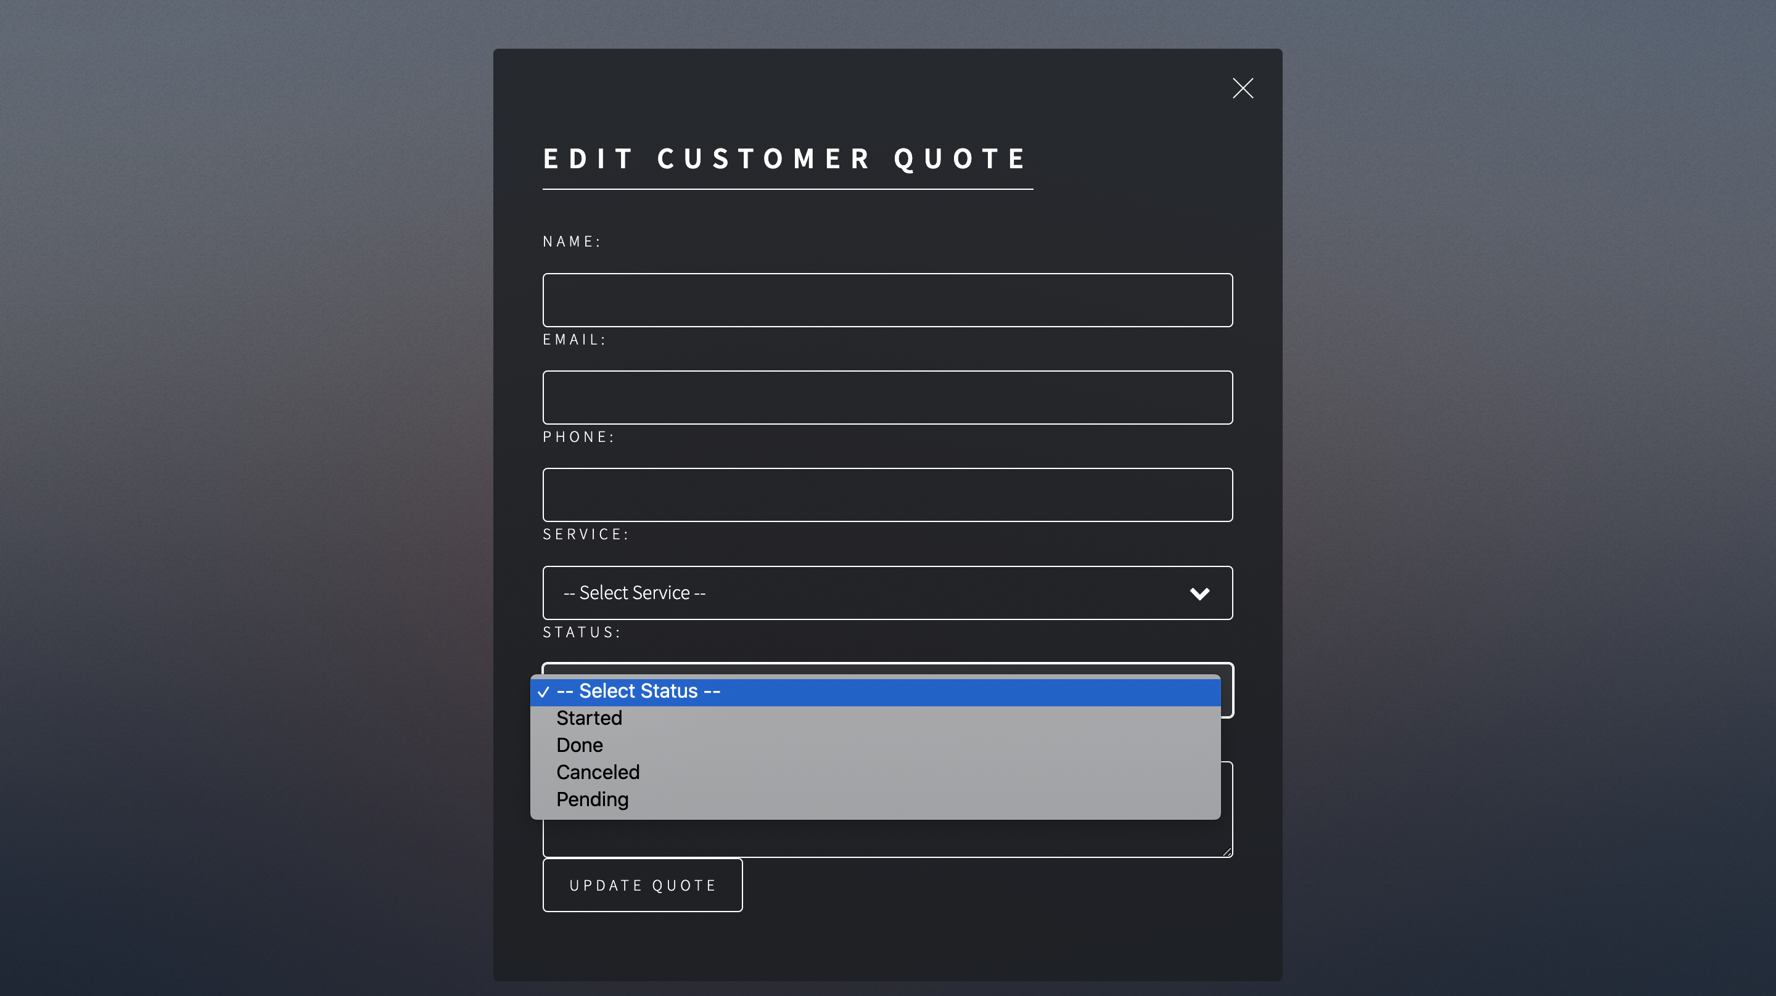
Key Task 4 – Edit Customer Quote Status

Slide 21
Key Task 4 – Confirm Quote Update

Slide 22
Key Task 5 – Make Sure You Log Out

Slide 23
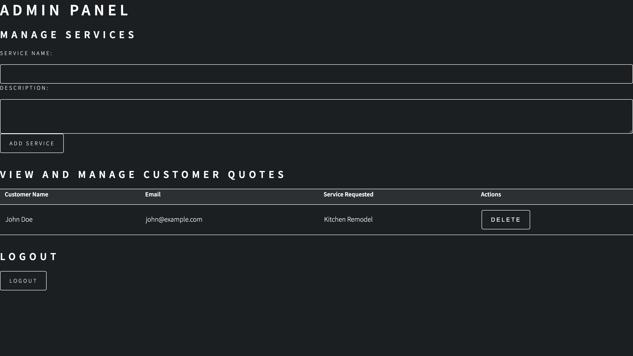
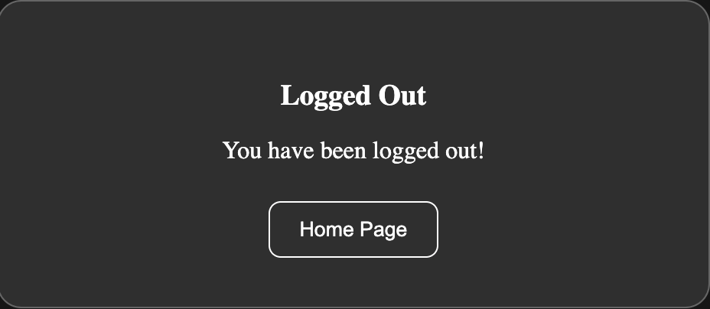
Key Task 5 – Log Out Confirmation

Slide 24
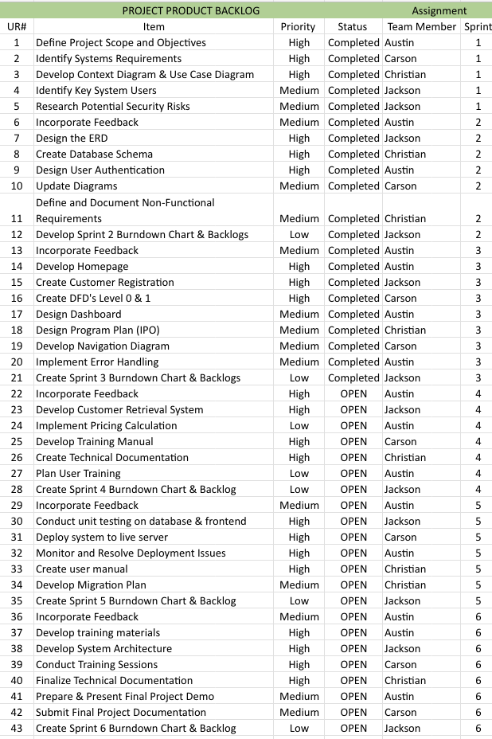
Updated Product Backlog

Slide 25
Sprint 4 Backlog
SPRINT 3 BACKLOG |  |  |  | Assignment
UR# | Item | Priority | Status | Team Member
22 | Incorporate Feedback | High | Completed | Austin
23 | Develop Customer Retrieval System | High | Completed | Jackson
24 | Implement Pricing Calculation | Low | Completed | Austin
25 | Develop Training Manual | High | Completed | Carson
26 | Create Technical Documentation | High | Completed | Christian
27 | Plan User Training | High | Completed | Austin
28 | Finalize Sprint 4 Burndown Chart & Backlog | Low | Completed | Jackson

Slide 26
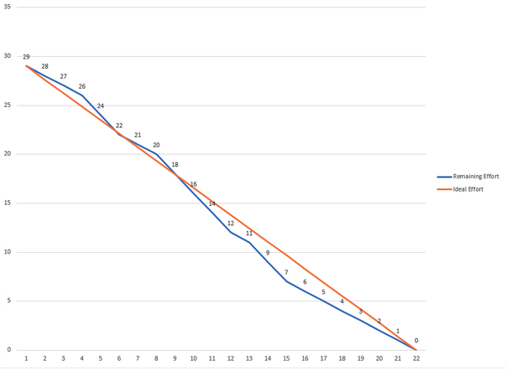
Sprint 4 Burn Down Chart

Slide 27
Project Updates
Created a training manual for new users
Added some pop ups to give more clarity to users
In the process of linking the external database to the site

Slide 28
Sprint 4 PSPI
Admin Login
Pop-Ups

Slide 29
Sprint 4 PSPI
Admin Edit Panel
Service Dropdown
Status Dropdown

Slide 30
Questions?

